Slide 1
Painter
Classification
By: Lillian Mansour

Slide 2
Intro
The main goal is to examine pairs of paintings and predict whether the paintings belong to the same artist or not.
PAGE 02

Slide 3
Data Creation
01.
Training Data- Triples: 19092
Artists: 783
02.
Validation Data- Triples: 3883
Artists: 198
03.
Test Data- Triples: 4737
Artists: 195
PAGE 03

Slide 4
Training Data Augmentation
I used augmentation to reduce the overfitting of the model.
Random Rotation (15 degree)
Random Horizontal and Vertical Flip
Random Affine Transformation
Normalization
Center Crop to 224 x 224
PAGE 04

Slide 5
Val & Test Data Augmentation
Normalization
Center Crop to 224 x 224
PAGE 05

Slide 6
DataSet Class
Designed to load images dynamically, meaning it fetches them from storage as they're requested rather than loading them all at once.
This reduces memory usage, making it suitable for large datasets on systems with limited RAM.
PAGE 06

Slide 7
How it works?
DataLoader
Batch Data
DataSet
getitem
(resized already)
augmentation
PAGE 07

Slide 8
Network
Utilizes a pre-trained ResNet-18 model.
Adjusts the fully connected layer (last layer) to produce embeddings of 256 dimensions.
Accepts three input images (img1, img2, img3).
Returns computed embeddings of each image.
Architecture
Forward
PAGE 08

Slide 9
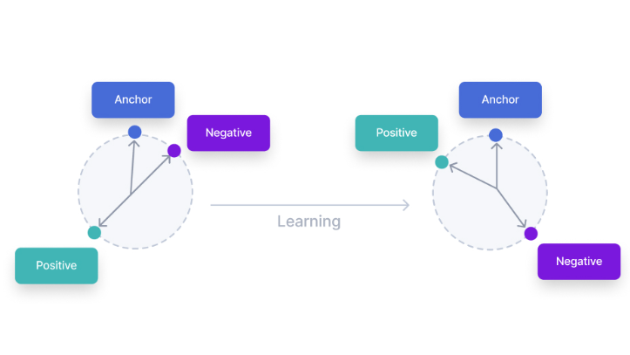
Triplet Loss
Calculates the triplet loss using the margin formula.
Applying ReLU to enforce positive contribution.
Returns mean loss.
The margin represents the minimum difference between the distance of anchor-positive pairs and anchor-negative pairs.
PAGE 09

Slide 10
Training, Val and Testing
Using adam optimizer, triplet loss, batch size of 128 and learning rate = 0.00001
Training
loop
Validation
loop
Test
Note: The data in the test set comprises 20% of the training data.
PAGE 10

Slide 11
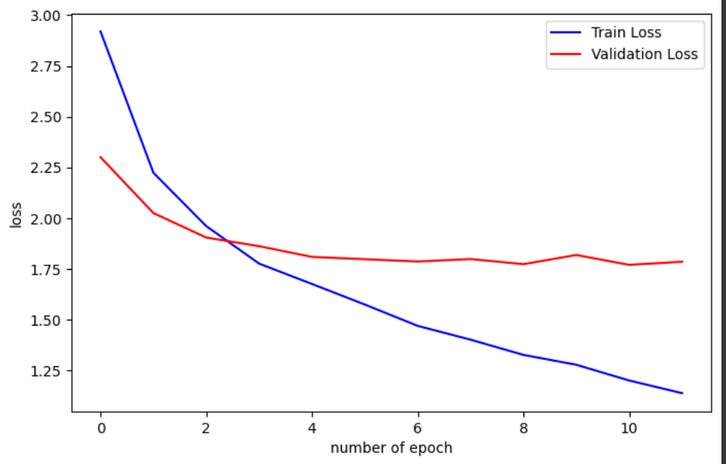
Loss Plot
PAGE 11

Slide 12
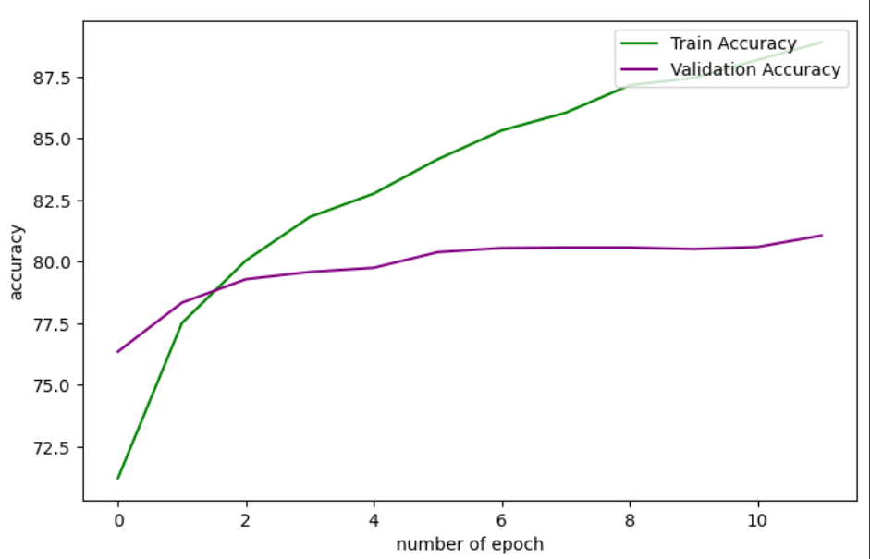
Accuracy Plot
PAGE 12

Slide 13
Best test accuracy
The highest accuracy I got was in epoch 12:
PAGE 13

